Slide 1


Style Sheet & Standard Guide
January 2015

Slide 2
Purpose
The purpose of this document is to establish guidelines for consistent presentation, production, and correspondence Style Standards
Style Standards include (but are not limited to):
Abbreviations/Acronyms
Bullets
Capitalization and Initial Capitalization
Colons and Semicolons
Commas
Company Names
Contractions
E.g. and i.e.
Footnotes
Grammar
Legal Conventions
“MM” vs. “M” or “Millions”
Number Conventions
Page Captions/Headings/Titles
Proofreader's Symbols
Spacing after Sentences
Spelling
Tables
Taglines/Headlines
Text and Font Standards

Slide 3
Abbreviations/Acronyms
Keep abbreviations consistent throughout a document and across multiple document for the same client
Common abbreviations such as US and USA must be consistent throughout a document. While “U.S.” and “US” are both acceptable, our preference is for “US,” without periods. The same applies for “U.S.A.” and “USA”
Capitalized abbreviations/acronyms for technical terms such as “FTE” for Full Time Employee, also do not need periods. However, the plural form is FTEs (i.e., capital letters for the abbreviation and small “s” for the plural form). This remains consistent for all abbreviated technical terms with the exception of company, country, or proper names (e.g., USA’s)

Slide 4
Bullets
Text:
Bullets and sub-bullets begin with a word that is initially capitalized, similar to a regular sentence
Do not use periods at the end of bullets and sub-bullets. Multi-sentence bullets have periods at the end of every sentence except the last one
Formatting:
The first level bullet is a Filled Round Bullet (Normal Text #2022) – This is a preset choice on the bullet drop down box
The second level bullet is an en dash (Calibri #2013)
The third level bullet the same as the level one bullet (#2022)
The fourth level bullet is the same as the level two bullet (Calibri #2013)
The fifth level bullet is custom – Calibri #00BB
Bullet character are left-aligned with the beginning of the line above it. The same is true of sub-bullets

Slide 5
Capitalization and Initial Capitalization
Capitalization and initial capitalization must be consistent throughout a document (e.g., the “Borrower,” and “IT Systems” as opposed to the “borrower” and “IT systems”). This is especially true for proper and process names
Headings, page captions, and/or titles are capitalized (Refer to the Page Captions/ Headings/Titles sub-section for more information and examples)
Words that are usually capitalized (excluding page headings/titles and Headlines) include proper names, company names, process names, legal definitions/ conventions, and process abbreviations
Title Case: When a whole sentence is initial capped it is termed Title Case. This is often used for headlines/taglines and usually excludes particles/prepositions such as “and,” “or,” and “of”
All caps is usually reserved for page headings and acronyms

Slide 6
Colons and Semicolons
Colons (:):
Use a colon after a title at the beginning of sentence. After the colon insert one space and then capitalize the subsequent word (e.g., Title: Capitalize the first word)
Use a colon in bulleted lists after the words “including” and “following”
As a general rule of thumb, use colons rather than semicolons
Semicolons (;) vs. commas
Semicolons are acceptable used in numbered lists (e.g., 1) pears; 2) apples; 3) oranges; and 4) bananas) – however it is equally correct to use commas. The CAST standard is to use commas rather than semicolons
Semicolons are used in sentences in which two (or more) distinct thoughts appear. A good guide is to ask whether these thoughts could stand alone as a complete sentence. If the answer is yes, a semicolon may be used to separate them. If the answer is no, use a comma

Slide 7
Commas
Commas (,) are generally used to indicate a separation of ideas or of elements within the structure of a sentence. Commas are also used to mark the smallest divisions of a sentence or thought
Use commas to separate parts of a list, i.e., “apples, pears, oranges, and cucumbers”
The serial comma is the CAST standard. This refers to using a comma before the words and/or in a list. The serial comma and the word and are highlighted in the following example: “apples, pears, oranges, and cucumbers”
Commas vs. Semicolons. Refer to the previous sub-section on Colons and Semicolons

Slide 8
Company Names
Company names are generally initially capitalized, unless the company uses all caps, all lower case, or a trade-marked combination of the two
Spelling of company names must be consistent throughout the document(s). Please check/verify the correct spelling of company names before submission to the Production department
When referring to the client company in a document, it is often customary to initially capitalize the C in “company,” (e.g., “the Company”). Similarly, when the client is a bank, the entity may be referred to as “the Bank”

Slide 9
Contractions
Avoid the use of contractions. Spell out “cannot” instead of “can’t” and “does not” instead of “doesn’t,” etc.
Its vs. It’s:
Its is the possessive form of the pronoun it and is correctly written without an apostrophe (e.g., Bank of America has stepped up its operations). It should not be confused with the contraction it's (for it is or it has), which should always have an apostrophe
Refer to the Grammar sub-section for more on this and other common mistakes. Also refer to the information contained in the Bootcamp Written Communications material

Slide 10
E.G. and I.E.
E.g. is an abbreviation of “exempli gratia” (Latin) and means “for example”
I.e. is an abbreviation of “id est” (Latin) and means “that is” or “that is to say”
Both e.g. and i.e. should be in lower case, with periods after each letter*. Use a comma (not a colon) before citing the example
Frequently, phrases containing i.e. and e.g. are enclosed in parentheses
*Exception: Capitalize the first letter of e.g. or i.e. if it is the first word of a sentence.

Slide 11
Footnotes
Number footnote references in the body or title of text sequentially (1, 2, 3, etc.)
Alternately, use lower case letters (a, b, c) or asterisks (*, **, ***)
The footnote reference is always in superscript, e.g., See note below¹
The footnote is placed at the left lower corner of the document and is in 9 point font, italicized
The footnote begins with the footnote reference number, in superscript
The CAST standard is to use periods at the end of footnotes
¹Footnote example.

Slide 12
Grammar
Follow the basic rules of grammar wherever possible
Please check with the Production department if you have a question concerning the correct usage of a particular word or phrase
Do not rely on MS Word’s and PowerPoint’s grammar check functions. While these functions are greatly improved in the 2010 office platform, they are not infallible
Common mistakes:
Its vs. It’s (refer to the Contractions sub-section)
Possessive form of plural nouns
Consultants’ =belonging to more than one consultant
Consultant’s = belonging to one consultant
General rule of thumb – words ending in s, or plural nouns, generally take the apostrophe (‘) after the s to indicate the possessive tense
Quotation Marks (“) Punctuation marks, such as commas, period, etc. are generally entered INSIDE the end quotation mark – e.g., We have consultants “around the globe.”
Refer to the Bootcamp Written Communications material for more information on grammar

Slide 13
Legal Conventions
Never alter company logos or trademarks without written consent from the company
Legal Definitions:
When defining terms as part of a contract or proposal (or other legally binding documents):
The term is identified. Often the term is highlighted by using bold font
The reference, acronym, or abbreviated form is placed in quotation marks and parentheses
After the reference, acronym, or abbreviation is denoted, the term is defined
The reference, acronym, or abbreviated version of the term is used for the remainder of the document
For example, Borrower (the “Borrower”) is defined as the party who has entered into a contract by supplying……
When quoting sources or copyrighted material, quotation marks are used with ellipses, where appropriate. Identify the source and/or author
Publication names are generally italicized or bolded to set them off from the rest of the note

Slide 14
“MM” vs. “M” or “Millions”
Spell out the word “millions” wherever possible
If space is an issue, use M or MM, but keep the convention consistent throughout the document (and particularly per page)
For more information refer to the “Tables” and “Number Convention” sub-sections

Slide 15
Number Conventions
Spell out numbers in sentences/paragraphs, where possible – particularly at the beginning of a sentence (e.g., “Four days notice in advance is required for personal days” as opposed to “4 days notice…”)
The general rule of thumb is to (1) spell out numbers from one to ten, and (2) use numbers for 11 and above
Use commas for separators for numbers in the thousands and above (e.g., 1,000 and 2,500,000 instead of 1000 and 2500000)
Use percentage symbols (%) for both numbers in a comparison or list:
E.g., 89% – 95%, as opposed to 89 – 95%
In tables, use percentage symbols consistently on all appropriate numbers
Dollar signs, like percentage symbols, should be used for all numbers in a comparison or list:
E.g., $50 – $100, not $50 –100
Tables: Refer to sub-section on Tables for dollar sign usage
Numbers in tables: Refer to Tables sub-section

Slide 16
Page Captions/Headings/Titles
Page Captions/Headings: Page Captions are entered in a blank (unfilled, no line or shadow) text box at the top of the body of the page and the text is Initially Capitalized. This means that the first letter of each word is capitalized (note: articles and conjunctions may be exceptions).
The Heading or Slide Title (note, this is different from the tagline or headline text at the top of the page in the blue banner) is generally 26 point and is centered on the page
The standard font color is dark orange/brown. Alternately, dark blue, gray or green may be used.
Titles/Sub-Titles: Similar to headings, titles are often entered in text boxes under the main heading and over objects, tables or text boxes containing relevant material. Titles may be fully capitalized or initially capitalized (Title Case) and are in smaller font size than the Page Caption or Heading (generally 16 pts or less, depending on layout/fit)
Sub-title boxes may also have solid fill (no line or shadow) using the standard CAST color palette
Sub-Headings are fully capitalized and are in the top left hand corner of the page. (These generally refer to section titles within a document)

Slide 17
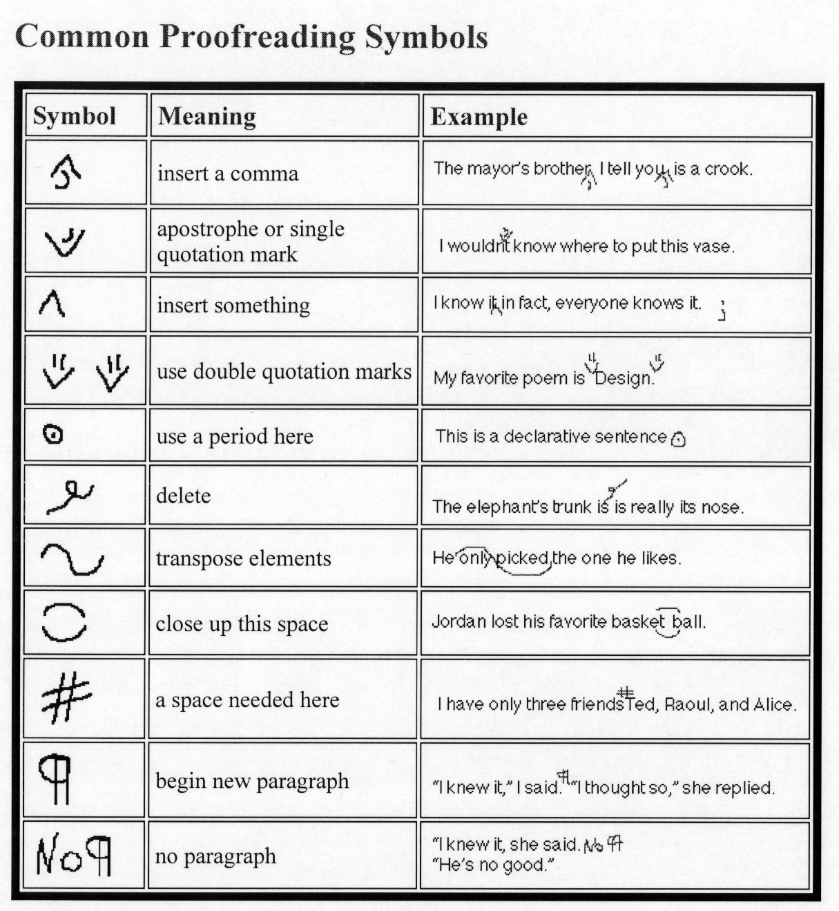
Proofreader's Symbols
Below is a list of common proofreading symbols:

Slide 18
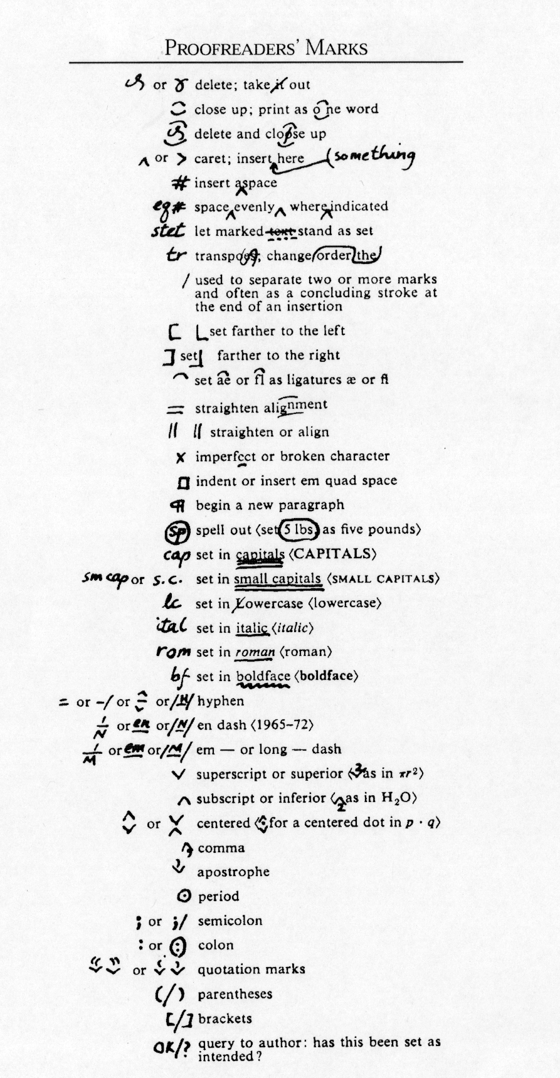
Proofreader’s Symbols (Continued)

Slide 19
Spelling
The spelling of company names and proper names needs to be consistent throughout the documents. Please check the correct spelling of these names BEFORE submission to the Production Department
Check for consistency in abbreviations or acronyms used
Spell Check is our friend

Slide 20
Spacing After Sentences
Separate sentences by inserting two spaces after the period
Keep sentence spacing consistent throughout the document
Note that one space or three spaces between sentences are also acceptable, however the CAST standard is two spaces

Slide 21
Tables
Table titles are generally uppercase, bolded and centered. Alternately, they may be in Title Case (still centered and bolded). Titles are center aligned vertically within the cells. Alternately, titles may be bottom aligned within the table cells
Categories (far left column of table) are usually left aligned (horizontally) and center aligned (vertically) within the cell. NOTE: When column entries are uniformly left aligned, the title of that column may be left aligned as well, instead of center aligned
Numbers within tables should be either right aligned, decimal aligned, or both, preferably centered both vertically and horizontally within the cell
Dollar signs:
Do not use spaces between the dollar sign and the currency value (e.g., $1,000 not $ 1,000)
In columns where the currency format is consistent, dollar signs may be used either at the top of the column and for totals and subtotal or throughout the entire column
Percentage signs: Similar rules to Dollar signs above
Millions, 000s, etc.: Where the denomination is consistent throughout a table, “$ in Millions” or “000s” may be placed (in parenthesis) at the top left hand of the table or in the Title itself under the main heading

Slide 22
Taglines/Headlines
The main headline or tagline is entered at the top of the page in the blue banner.
Headlines/taglines are typically Sentence Case, with the first word of the headline or sentence initially capitalized and the rest of the sentence in lower case (except for proper and company names, etc.)
Font size is 20 pt, bold
Font color is white
Headline format is “stair-stepped,” descending from left to right. If the tagline is too large to fit into this format the font size is reduced by 2 pts to 18 pt
Periods are NOT used at the end of the headline. If the headline contains more than one sentence, periods are used to separate the sentences, but are never used for the final sentence of the headline
Ellipses (…) are used at the end of the tagline if a thought/sentence is spread across two pages. In this case, the tagline of the following page begins with an ellipsis
Ellipses may also be used to show that the thought continues in the body of the page. Alternatively, a colon is used to show the continuation of thought

Slide 23
Text And Font Standards
PowerPoint Presentations:
Standard font is Calibri for all PowerPoint Presentations
Font size for taglines is 20 pt, bold
Font size for Title text boxes is 26 pt
Font size for subheaders and footers is 9 pt and italicized
Additionally, Subheaders are in uppercase
Font size varies in textboxes and objects in the body of a slide, but are generally 2 points lower than titles and headers.
Line spacing in PPT – standard is .9 lines with .6 space after a paragraph. When more space is needed, alter space after the paragraph and/or lower the font size. Change the standard .9 line spacing only as a last resort.
MS Word documents:
CAST standard for Word is Calibri font at 11 pts. Arial may also be used
Lines are single spaced
Paragraph spacing is at 6 pts between paragraphs

Slide 24
Final Note
We know that all presentations are ultimately tailored to the needs and preferences of our clients, as their satisfaction is key to our success
Some clients require us to use their own templates and style standards
Some clients are more formal than others. The language used in presentations for these clients should reflect their standards
That said, we believe these guidelines to be a solid blueprint for consistent, progressive, and upstanding presentations

